Slide 1
Air Quality Index (AQI) Analysis
Narendra Reddy

Slide 2
Index
Problem Statement
Data Preprocessing
Insight 1: Which are the cities with high and low AQI?
Insight 2: Possible causes of Ahmedabad’s high AQI.
Insight 3: Peak hours of high AQI in Ahmedabad.
Insight 4: AQI over the year 2018 at 3AM in Ahmedabad 2018.
Future Work
Thankyou

Slide 3
Problem Statement:
Finding the possible causes for city with Highest AQI.

Slide 4
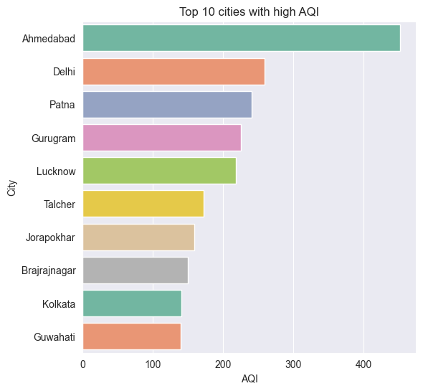
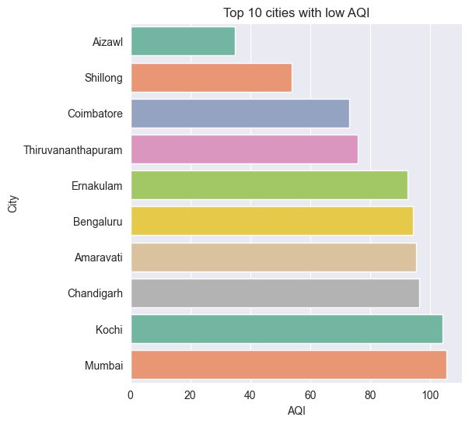
Which are the cities with high and low AQI?
AQIs of Cities:
Ahmedabad: 452.123
Delhi: 259.488
Patna: 240.782
Gurugram: 225.124
Thiruvananthapuram: 75.878
Coimbatore: 73.023
Shilong: 53.795
Aizawi: 34.766
(a.) Cities with High AQI
(b.) Cities with Low AQI

Slide 5
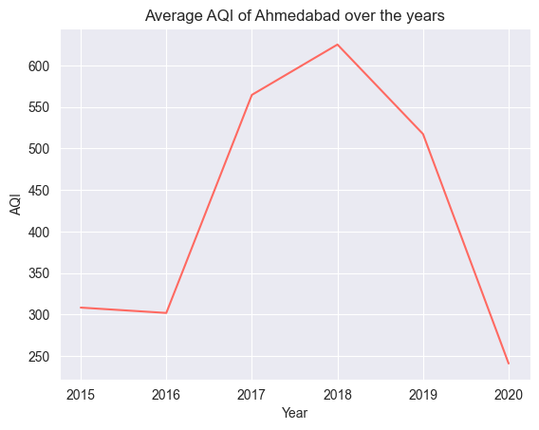
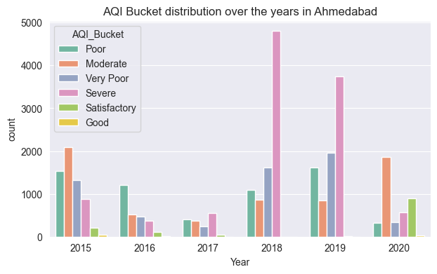
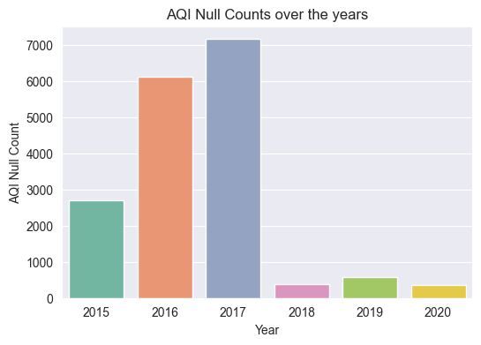
2. Possible causes of Ahmedabad’s high AQI
2018 has overall more records.
So we chose to investigate 2018 in detail.

Slide 6
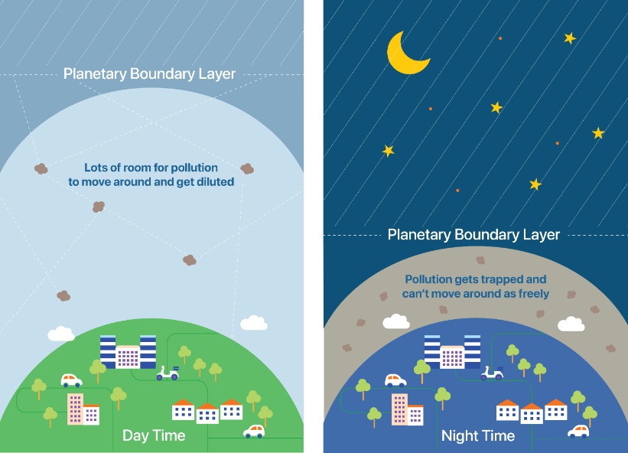
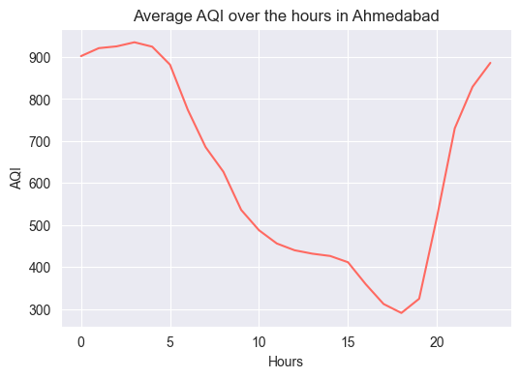
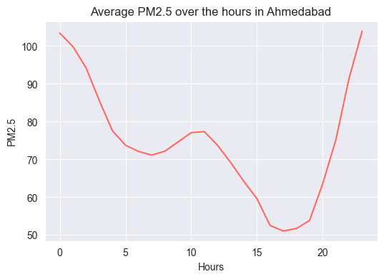
3. Peak hours of high AQI in Ahmedabad 2018.
Possible reasons for high AQI around midnight:
During night, the planetary boundary layer restricts the pollution particles to be trapped & limit their movements (link)

Slide 7
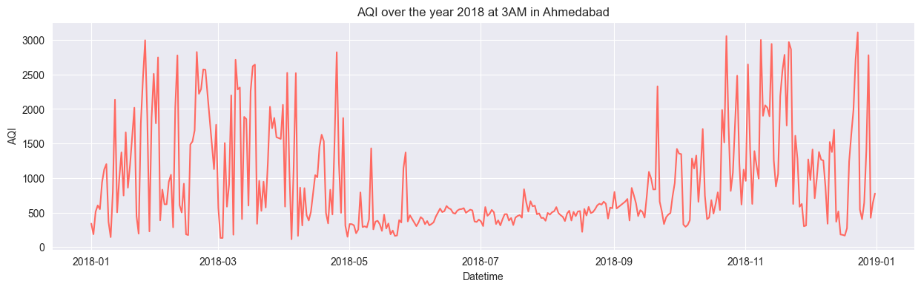
4. AQI over the year 2018 in Ahmedabad 2018.
Average AQI is relatively low from June to September.

Slide 8
Future Work
Station wise analysis.
Analysing the most affecting pollutants in every city or stations in a city.

Slide 9
THANK YOU.

